Slide 1
Potato Disease Prediction
Presented by:
1.SUNIL B E -R23EA124
2.THARUN GOWDA CS -R23EA129
3.VIKAS KUMAR -R23EA132
4.VINAYAK -R23EA134

Slide 2
Problem Statement
Farmers often face heavy losses due to late identification of potato diseases like Early Blight and Late Blight.
Most of them depend on manual observation which is time-consuming, inaccurate, and requires expert knowledge.
By the time symptoms are visible, the infection might have already spread to other plants, leading to reduced yield and income loss.

Slide 3
Product/ Solution - Innovation
We propose an AI-based image classification model to predict potato leaf diseases.
Farmers can take a photo of the potato leaf using a mobile camera.
The system will analyze the image and predict whether the leaf is healthy or infected.
It also provides suggested remedies and preventive measures.
The solution aims for accuracy, speed, and ease of use.

Slide 4
Working Principle
Step 1: Collect potato leaf images from open datasets like Kaggle.
Step 2: Preprocess the images (resize, normalize, augment).
Step 3: Train a Convolutional Neural Network (CNN) to classify diseases.
Step 4: Deploy the model using a Flask web application.
Step 5: User uploads a leaf image → Model predicts disease → Displays result and cure.

Slide 5
Innovations and Uniqueness.
Focuses specifically on potato diseases, unlike general crop app.
Provides real-time diagnosis using deep learning.
Designed to work even in low internet or offline mode.
Offers remedy suggestions in local language (planned feature).
Combines AI precision with farmer accessibility.

Slide 6
Product/ Solution - Readiness Level
Current Stage: Prototype (Proof of Concept)
Dataset: Potato Leaf Disease Dataset (Kaggle, 2,000+ images)
Model: CNN trained using TensorFlow/Keras
Interface: Flask web app (under development)
Next Step: Integration with Android app for farmers

Slide 7
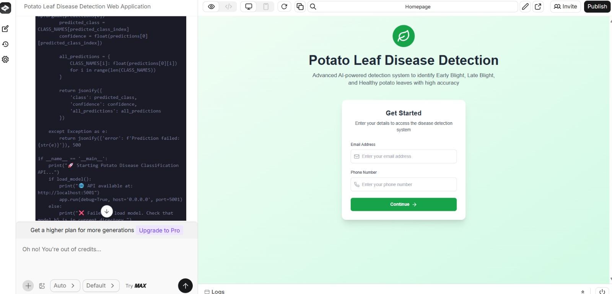
Product Readiness

Slide 8
Ideal Customer Profile
Target Users: Farmers, Agri Officers, and Crop Researchers
Region: Rural and semi-urban areas with large potato cultivation
Age Group: 25–60 years
Device: Smartphone users
Goal: Early and accurate disease detection to improve yield and income

Slide 9
Customer Persona
Name: Ramesh
Age: 38
Location: Hassan , Karnataka
Occupation: Potato Farmer
Challenges: Struggles to identify diseases early
Goals: Wants a simple, low cost tool to detect disease

Slide 10
Customer Insights
Farmers shared that they face repeated crop loss due to unrecognized leaf spots.
Many use wrong pesticides because they can’t identify the problem.
They prefer apps that are simple, visual, and available offline.
Most are ready to use AI-based tools if explained clearly in their language.
Feedback helped us focus on simplicity and practicality in design.

Slide 11
Team Size, Background, Strength /Capability and Resources
Name | Designation | Contribution
Vikas | Team Lead | Model training & testing
Sunil | UI Developer | Designed flask web interface
Tharun | Back end developer | Designed and implemented the backend
Vinayak | System Integrator | Ensures all the modules work together.

Slide 12
Market Landscape - Market Potential, Competitors
India has over 2 million potato farmers, creating huge potential user base.
AI in agricultural is a growing market, expected to cross $3B by 2026.
Our system focuses only on potato.
Future Goals: Collaborate with agricultural departments and local cooperatives.

Slide 13
Business Model & Strategy
1.Revenue Model:
Free basic app for farmers.
Premium versions for Agri-officers.
Advertisement and partnership model with fertilizer companies.
2.Future Strategy:
Expand to other crops and regional languages.`

Slide 14
Product Milestones
1st Milestone: Minimal Viable Product(MVP)-IA2
Final working product demo with pitch-SEE

Slide 15
Total Budget, Required Support and Regulation
Category | Cost (₹)(approx.)
Hardware/Infrastructure | 15,000
Cloud / Server Resources | 10,000
Marketing & Awareness | 5,000
Development & Testing | 20,000
Documentation / Admin | 5,000

Slide 16
Support Needed
Mentorship for Deployment.
Funding for Scaling and Hosting.
Access to better image datasets.

Slide 17
THANK YOU

